Slide 1

DEPARTMENT OF COMPUTER SCIENCE ENGINEERING (ARTIFICIAL INTELLIGENCE AND MACHINE LEARNING)
AMB1321 – INTERNET OF THINGS
BATCH - 9
Presented by :
SAMEEHA J
SUDHARSON S R
VETHAABINAYA S
VIMAL AANANTH B R
Guided by :
Mr. C. MUTHUKUMARAN M.E., (Ph.D.)
AP – CSE(AIML)

Slide 2
Smart Energy Theft Detection System Using IoT and AI

Slide 3
PROBLEM STATEMENT
Electricity theft is a serious problem that causes major financial losses and affects the stability of power distribution systems. Traditional energy meters only record total consumption and do not have the ability to detect abnormal or suspicious usage in real time. Manual inspection methods are expensive, time-consuming, and often ineffective. Therefore, there is a need for a smart and automated system that can continuously monitor energy usage and intelligently detect possible electricity theft using IoT and Artificial Intelligence.

Slide 4
RESEARCH OBJECTIVE
The objective of this project is to develop a smart energy theft detection system that monitors real-time power consumption and identifies abnormal usage patterns. The system aims to provide a low-cost, efficient solution with instant alerts for detecting electricity theft.
📌 Scope of the Project
Real-time energy monitoring
Detection of abnormal usage
Instant alert generation
Load control using relay
Suitable for smart grid applications

Slide 5
EXISTING SYSTEM
Traditional electricity monitoring systems use basic energy meters that only record total power consumption and do not provide real-time analysis. Electricity theft detection mainly depends on manual inspection, which is time-consuming and inefficient. These systems lack the ability to identify abnormal usage patterns and do not generate alerts, making theft detection difficult.
📌 Limitations
No real-time monitoring
Cannot detect abnormal usage patterns
Depends on manual inspection
Low detection accuracy
No alert or notification system

Slide 6
PROPOSED SYSTEM
Real-time energy consumption is continuously monitored using an ESP32 microcontroller integrated with a current sensor. The collected data is transmitted via Wi-Fi to a cloud platform for intelligent analysis. A hybrid detection framework is implemented, combining Statistical Threshold Analysis and ML-based Anomaly Detection to accurately identify abnormal consumption patterns that may indicate electricity theft.
📌 Merits:
Accurate and reliable anomaly detection
Reduced false positives through hybrid verification
Real-time monitoring and alert generation
Low computational complexity & Suitable for smart grid applications
Cost-effective and scalable implementation

Slide 7
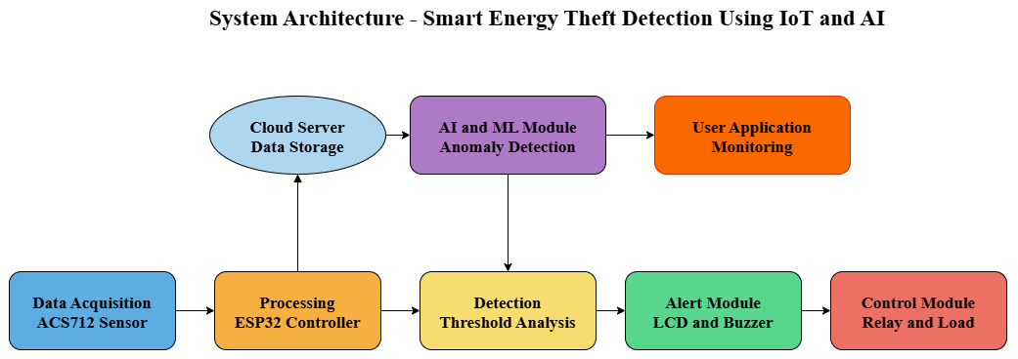
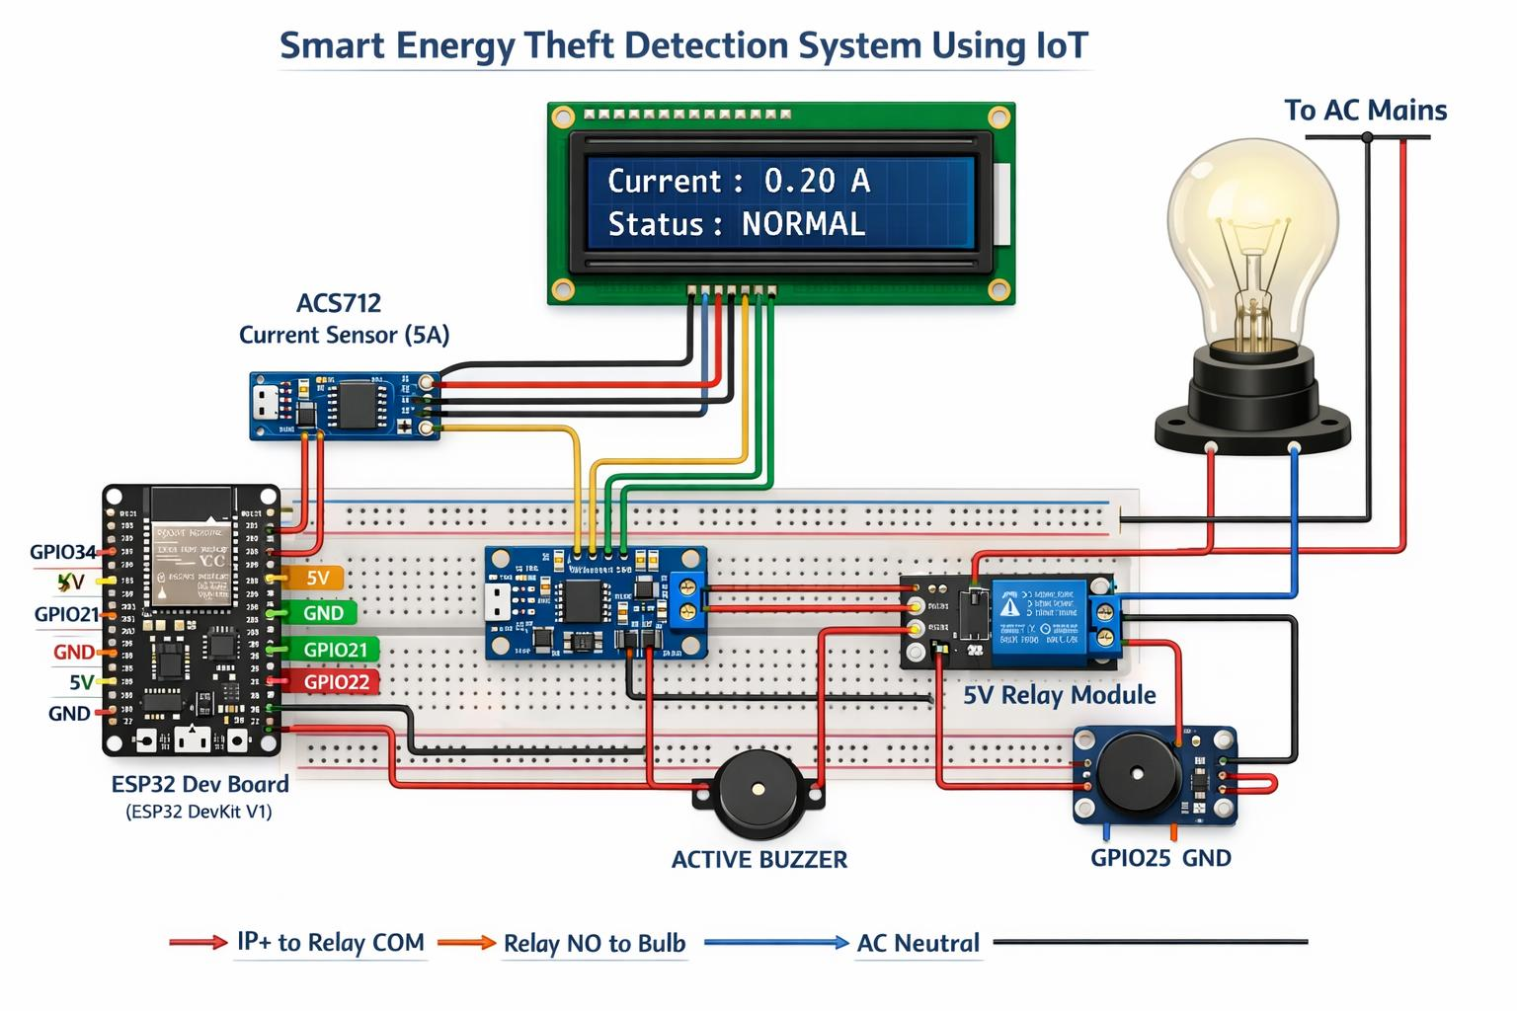
SYSTEM ARCHITECTURE

Slide 8
HARDWARE COMPONENTS
This project uses the following hardware components:
ESP32 Microcontroller
ACS712 Current Sensor
Relay Module
LCD Display (16x2)
Buzzer
Breadboard
Jumper Wires
Bulb & Holder

Slide 9
SOFTWARE REQUIREMENTS
The system is developed using embedded programming and required tools.
Arduino IDE
ESP32 Board Package
Embedded C / C++
Libraries: Liquid Crystal I2C, Wi-Fi

Slide 10
WORKING PRINCIPLE
The system follows a hybrid approach combining statistical analysis and simple anomaly detection to identify abnormal energy usage.
Current data is collected using ACS712 sensor
ESP32 processes real-time energy values
Statistical threshold (mean & deviation) is applied
Abnormal patterns are identified
Two-stage verification improves accuracy
Alerts are generated for detected anomalies

Slide 11
IMPLEMENTATION DETAILS
The project implementation is completed successfully with full hardware and software integration.
All required components have been procured and assembled.
Circuit connections are completed using a breadboard.
ESP32 is interfaced with ACS712 sensor and relay module.
LCD display and buzzer are integrated for output indication.
Complete wiring and hardware setup is finished.
Sensor readings are tested and validated.
Final coding and system integration are completed successfully.

Slide 12
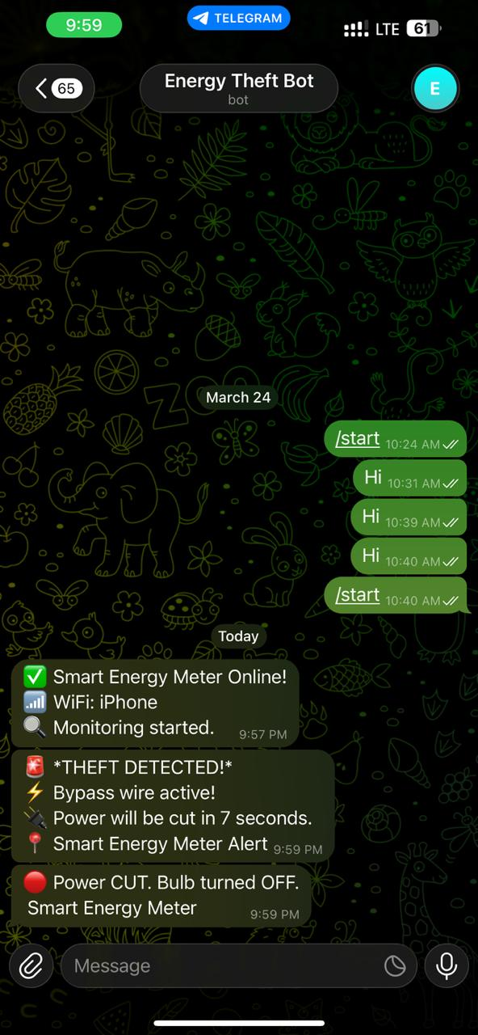
OUTPUT/ RESULT
The system successfully monitors energy consumption and identifies abnormal usage patterns in real time.
✅ Normal Condition
Stable current readings
LCD displays “NORMAL”
Buzzer remains OFF
Load operates normally
⚠️ Theft / Abnormal Condition
Sudden drop or irregular current detected
LCD displays “THEFT DETECTED”
Buzzer turns ON
Alert indication is generated

Slide 13
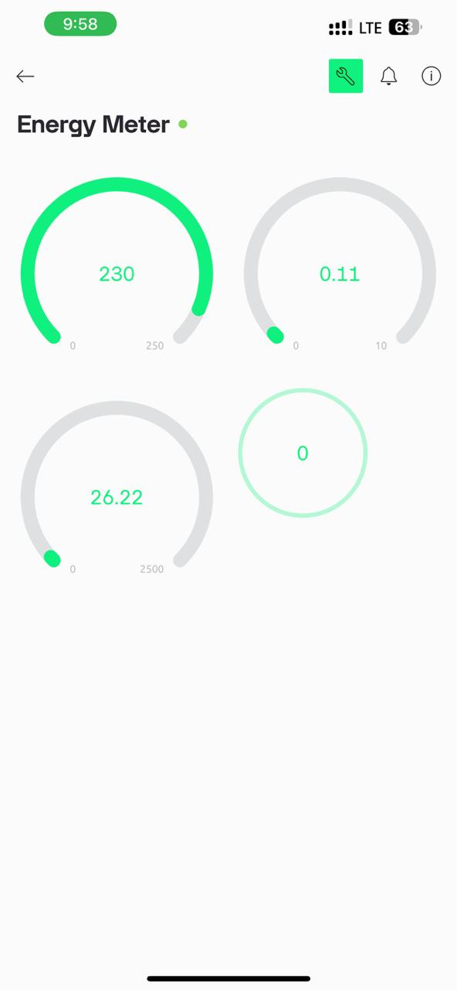
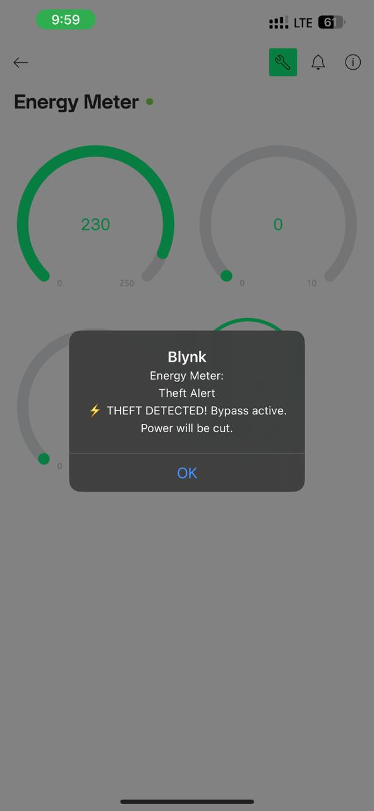
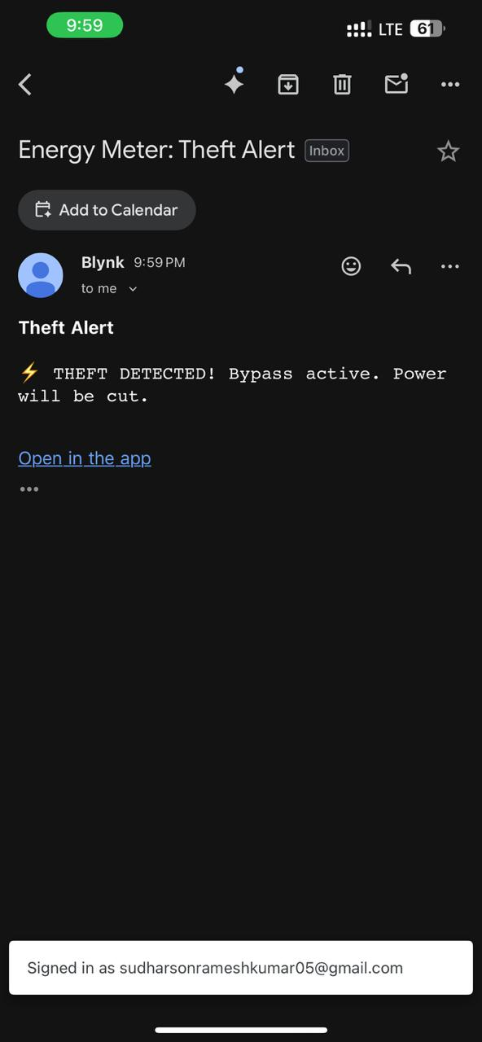
OUTPUT/ RESULT

Slide 14
CONCLUSION & FUTURE ENHANCEMENTS
This project demonstrates a smart energy monitoring system using IoT that can measure real-time power consumption effectively. The system has been successfully implemented with hardware setup and basic testing, showing stable performance under normal conditions. It provides a foundation for detecting abnormal energy usage and can be further enhanced to identify electricity theft accurately.
🚀 Future Enhancements
Implement advanced AI-based anomaly detection
Integrate cloud platform for remote monitoring & Develop mobile app for real-time alerts
Improve accuracy using calibration techniques
Extend system for large-scale smart grid applications

Slide 15
Thank You

